Slide 1
Zhuhai Property Management System
Yiting Mao 2130026105
Meng Xu 2130026169
Hanlin Wang 2130026135
Hailin Zhong 2130026215

Slide 2
Table of contents
01
02
04
05
03
Purpose
Conceptual
Design
Data
Collection
06
Data
Preprocessing
Database
Design
Frontend & Backend Functions

Slide 3
01
Purpose
Yiting Mao 2130026105

Slide 4
Introduction
Real estate is one of the pillar industries of China's national
economy. Therefore, in our project, we establish a Zhuhai Property
Management System to help users and agents to trade properties.
We provide an online solution that streamlines the processes
involved in inquiring about properties, submitting a house
purchase application, and managing agents and users.

Slide 5
02
Conceptual Design
Yiting Mao 2130026105

Slide 6
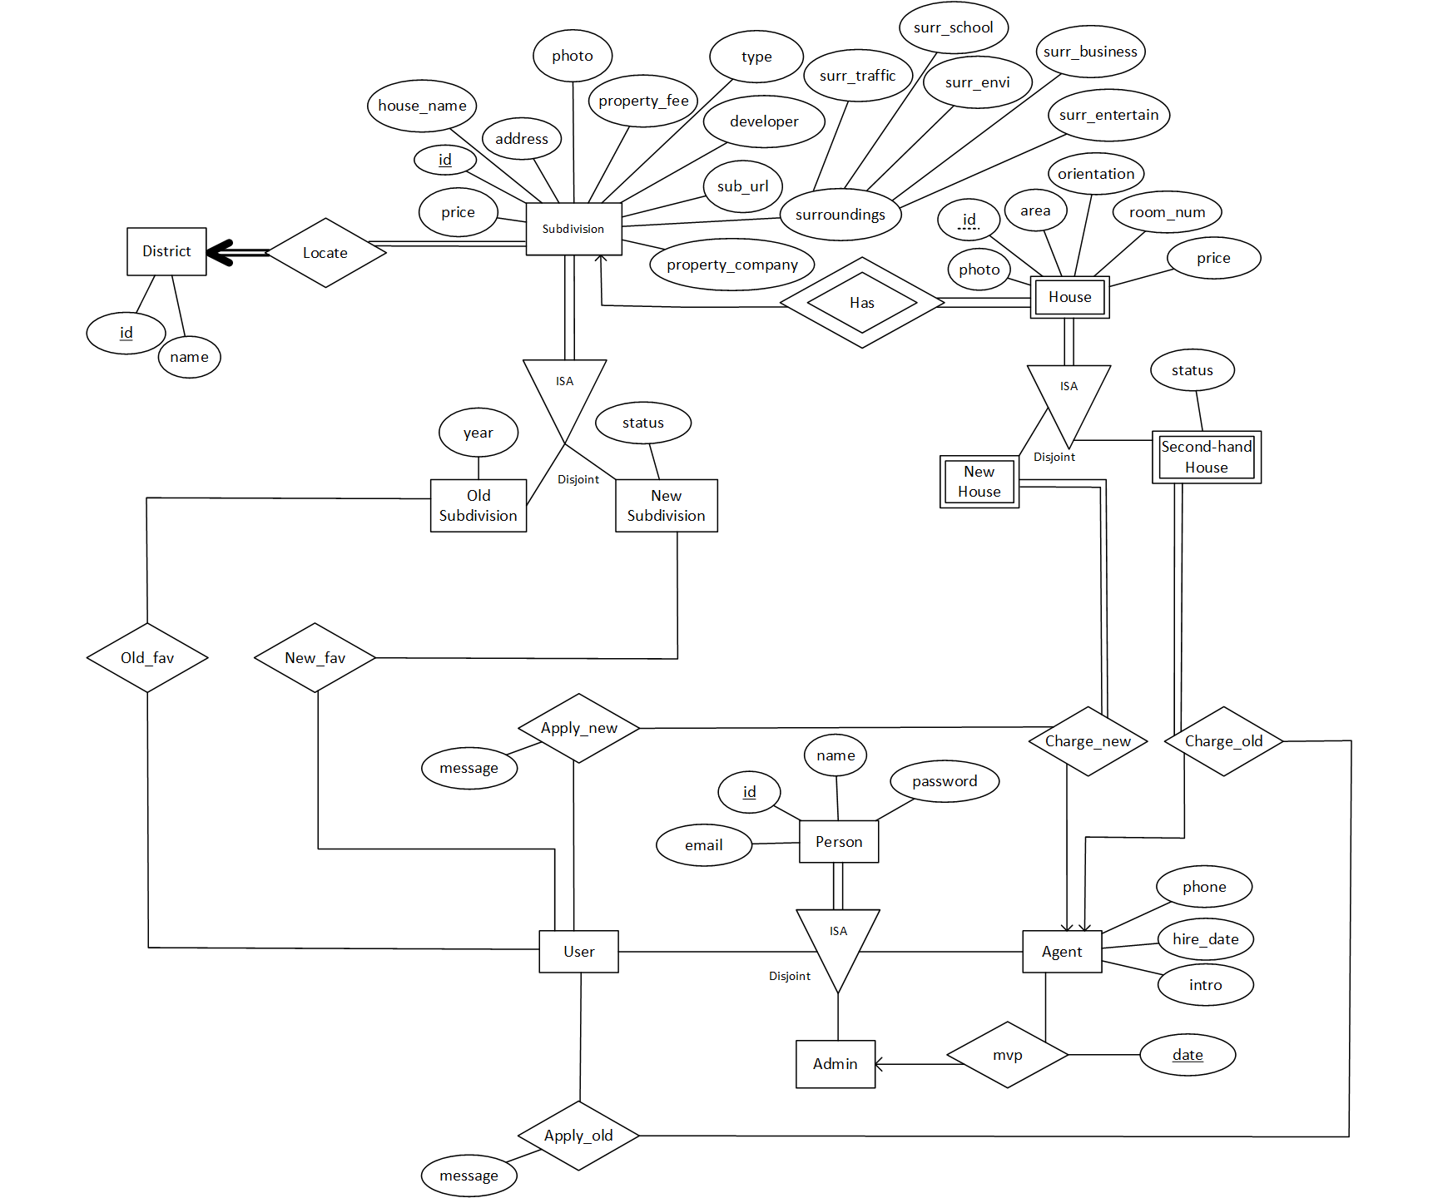
ER Diagram
Mainly composed of :
Three categories
Subdivision, house, person
One parent entity set
Two or three child entity sets
Total participates
The child entity sets are disjoint

Slide 7
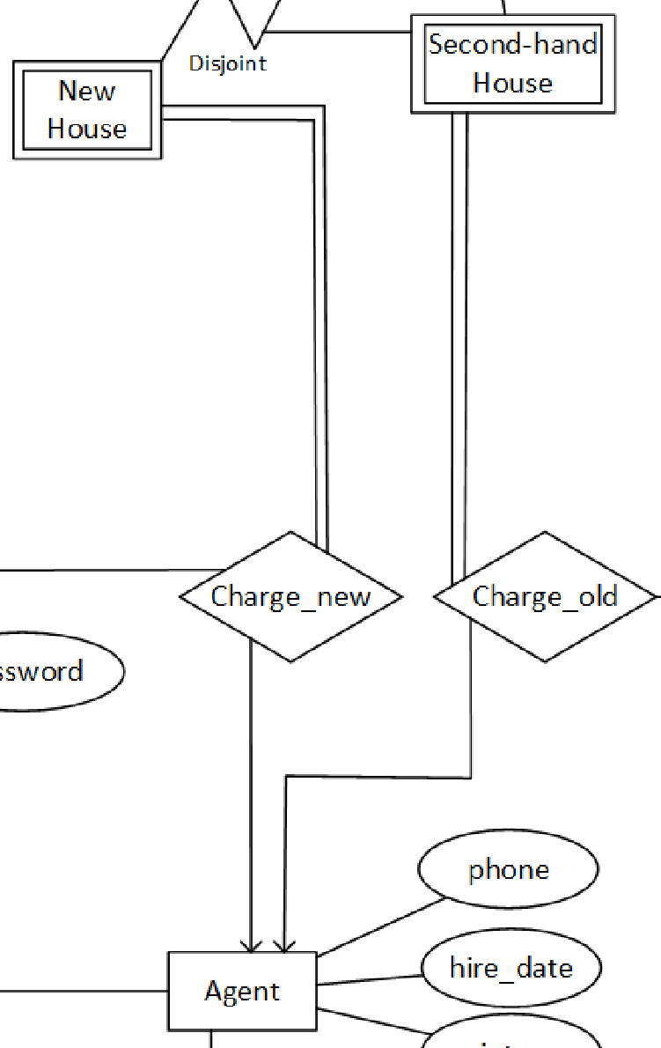
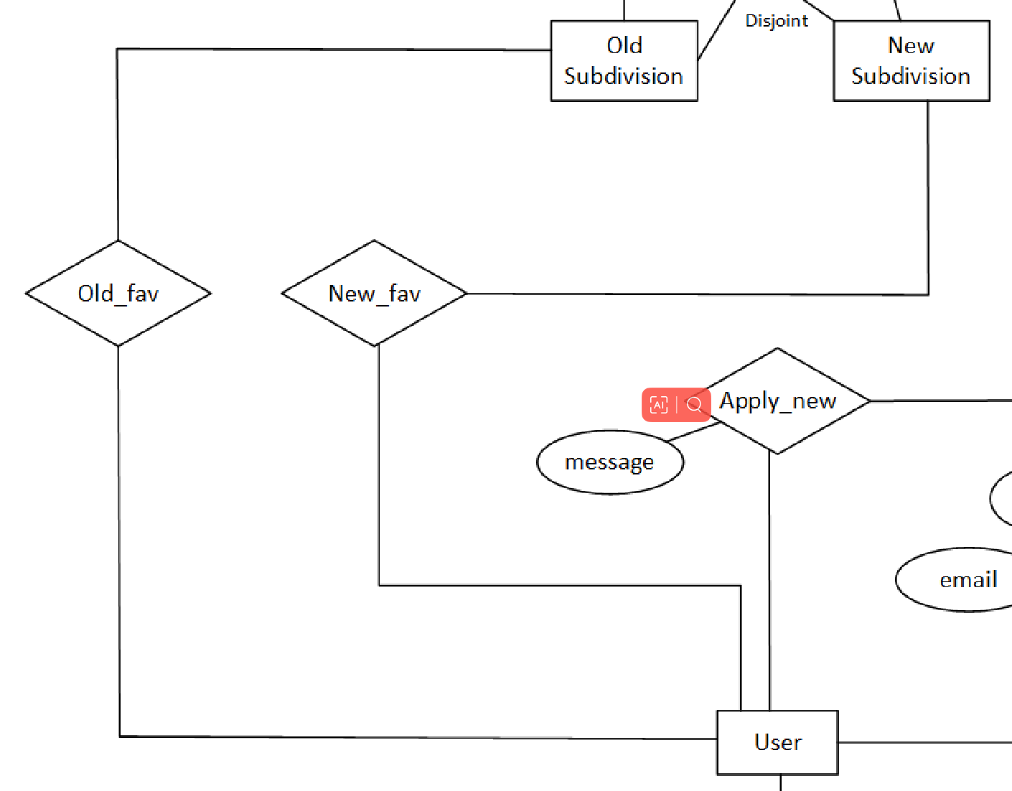
ER Diagram
Special place :
Fav and charge relationship set

Slide 8
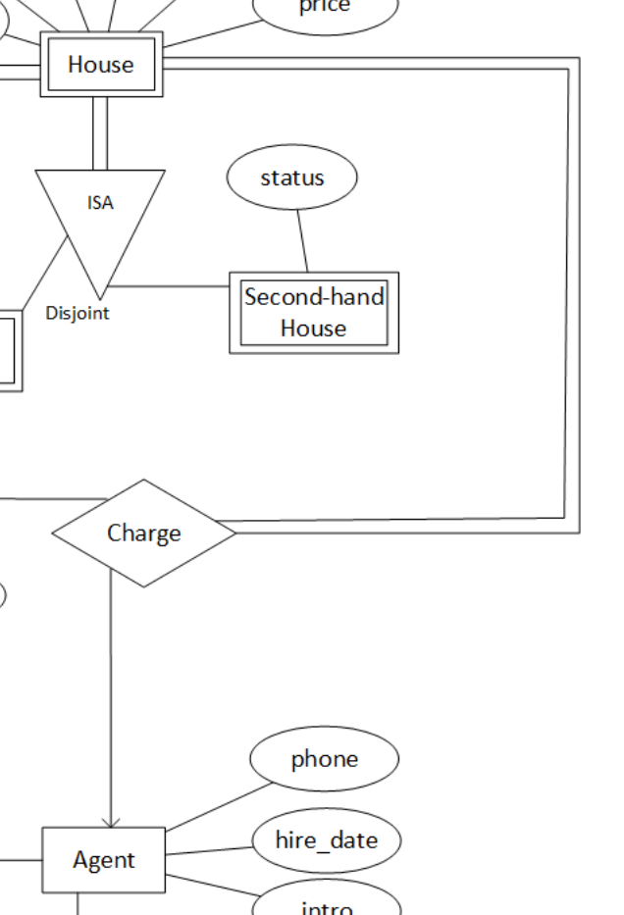
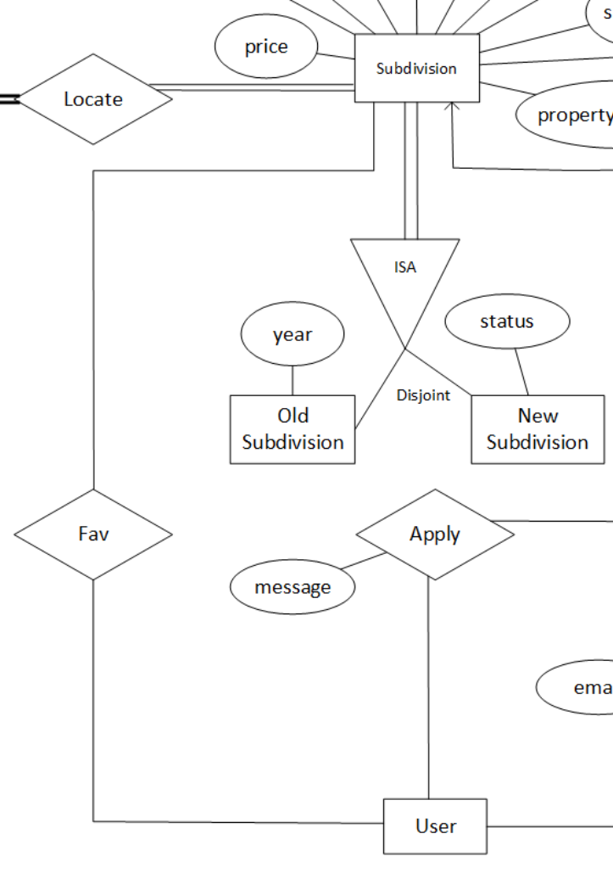
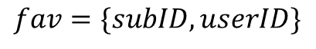
Old Version
Connect to the parent entity set rather than to every child entity set
One foreign key can’t connect with two primary keys
$$fav=\{subID,userID\}$$
Old subID
New subID
Repeated values between them

Slide 9
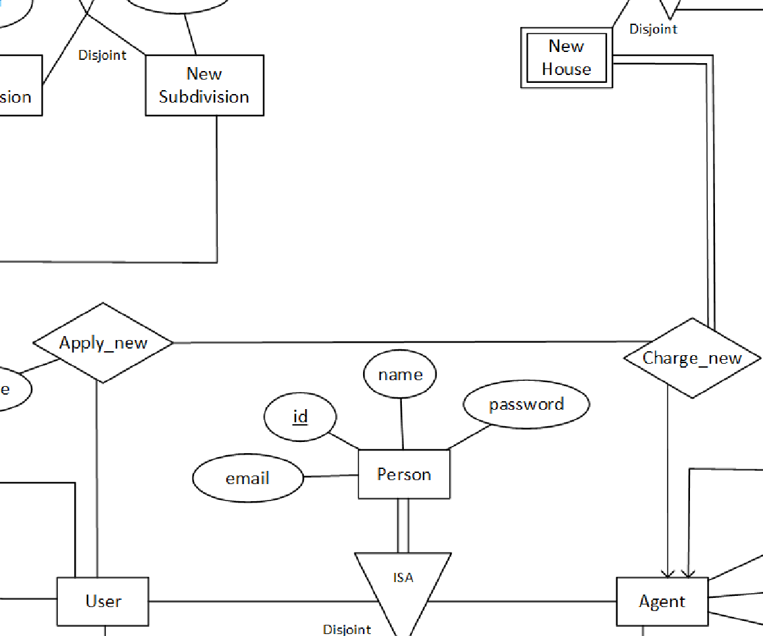
Aggregation
Special place :
Fav and charge relationship set
“apply” is an aggregation to another relationship set named “charge”
Meaning: Users submit the application to houses and agents as a combination.

Slide 10
Relationship Sets
New Table
Add Attributes
New_Apply = {user_id, sub_id, house_id, message}
Old_Apply = {user_id, sub_id, house_id, message}
New_Fav = {sub_id, user_id}
Old_Fav = {sub_id, user_id}
MVP = {agent_id, admin_id, date}
New_Subdivision = {id, district, …}
Old_Subdivision = {id, district, …}
New_House = {h_num, s_num, agent_id, photo, room_num, area, … }
Old_House = {h_num, s_num, agent_id, photo, room_num, area, … }
Locate
Locate
Charge
Charge

Slide 11
03
Data Collection
Yiting Mao 2130026105

Slide 12
Data Collection
Crawler
Faker
Random
All the data related to subdivisions and houses are authentic because they are obtained by crawling the web page of ZhengShun property.
People’s data is generated by the Faker package in Python.
The sentences about comments are generated by ChatGPT.
Other data, such as the ID of the relationship tables are randomly generated by Python.

Slide 13
04
Data Preprocessing
Meng Xu 2130026169

Slide 14
Data Cleaning
Data splicing
Delete data
Check data
Splicing of some data files
Delete abnormal data
Check for deleted data
Check data
De-duplication
Finally
Ensure that the data used as foreign keys are present in the source data
De-duplicate the data that needs to be used as primary keys
Get the final data

Slide 15
05
Database Design
Meng Xu 2130026169

Slide 16
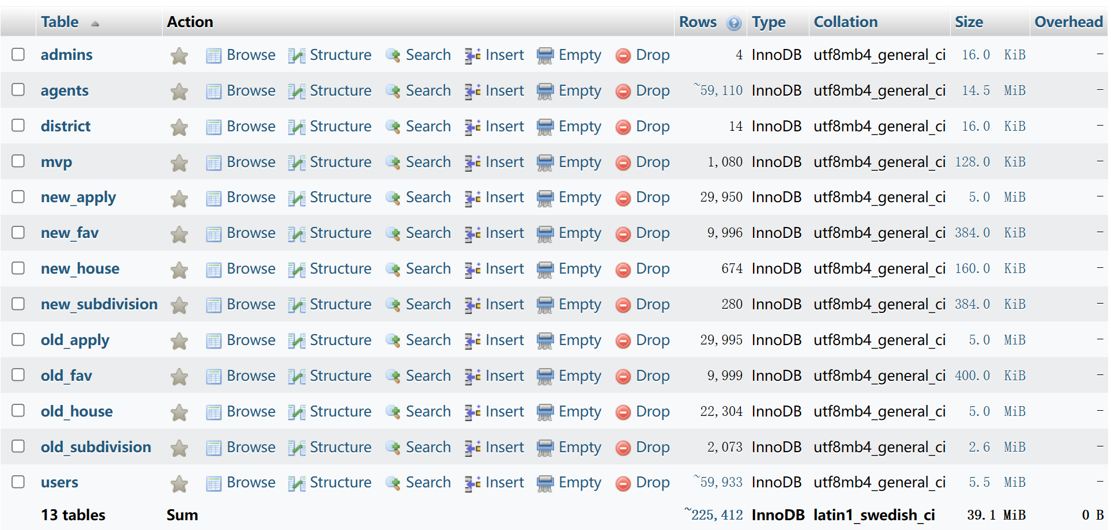
Database Display

Slide 17
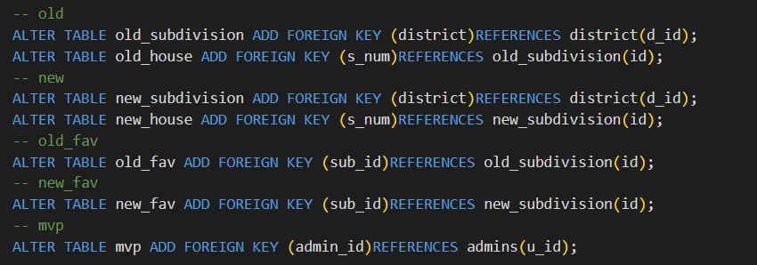
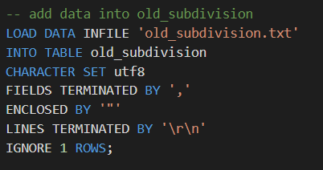
Foreign Keys And Data Import
Foreign Keys
Data Import

Slide 18

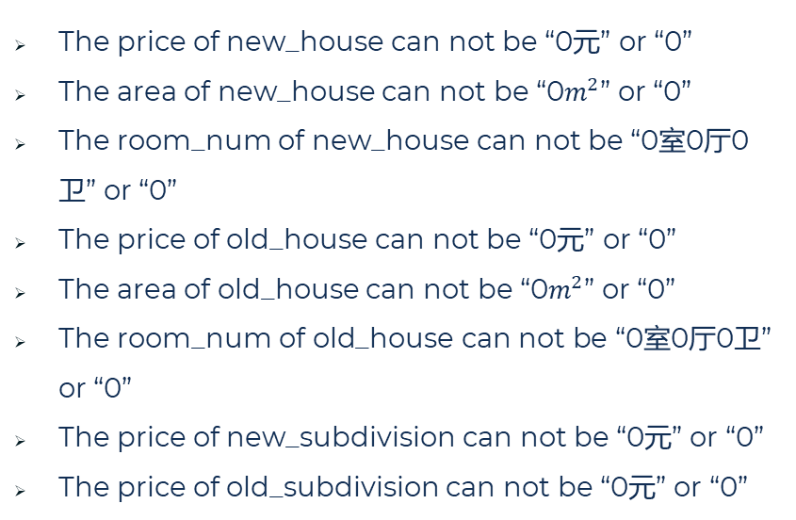
Constraints
The price of new_house can not be “0元” or “0”
The area of new_house can not be “0$m^{2}$” or “0”
The room_num of new_house can not be “0室0厅0卫” or “0”
The price of old_house can not be “0元” or “0”
The area of old_house can not be “0$m^{2}$” or “0”
The room_num of old_house can not be “0室0厅0卫” or “0”
The price of new_subdivision can not be “0元” or “0”
The price of old_subdivision can not be “0元” or “0”

Slide 19
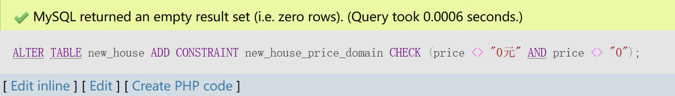
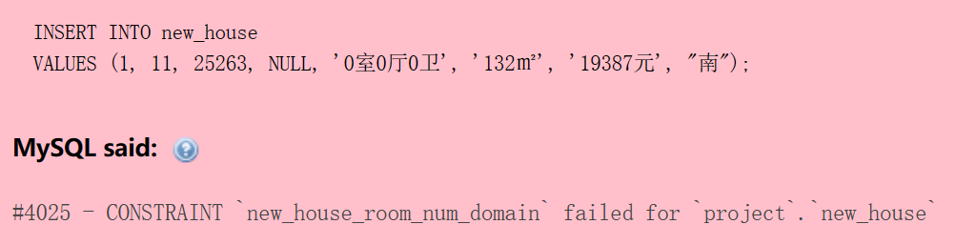
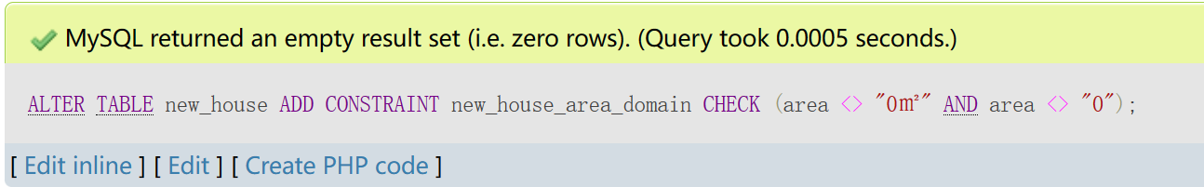
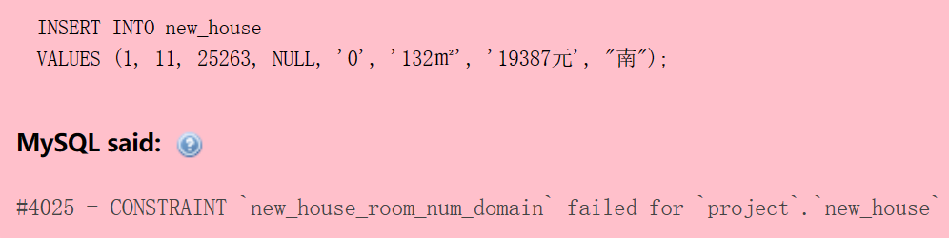
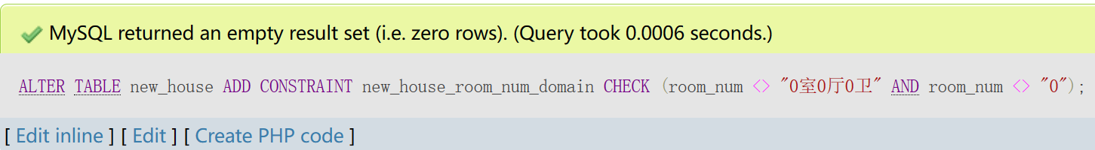
Example

Slide 20
Cascade And Triggers
Cascade:
delete or update one house from ‘old_house’ then ‘old_apply’ should also change
delete or update one house from ‘new_house’ then ‘new_apply’ should also change
Triggers:
delete or update one agent then ‘mvp’, ‘new_house’, and ‘old_house’ should also change as ‘agent_id’ changed
delete or update one user then ‘new_fav’, ‘old_fav’, ‘new_apply’, and ‘old_apply’ change as ‘u_id’ changed

Slide 21
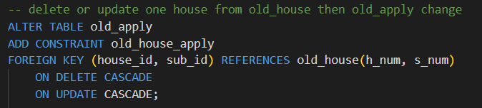
Example – cascade delete & update

Slide 22
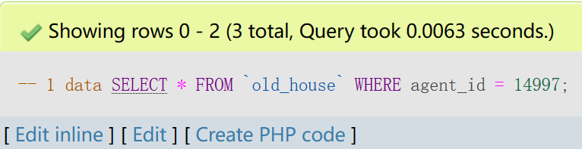
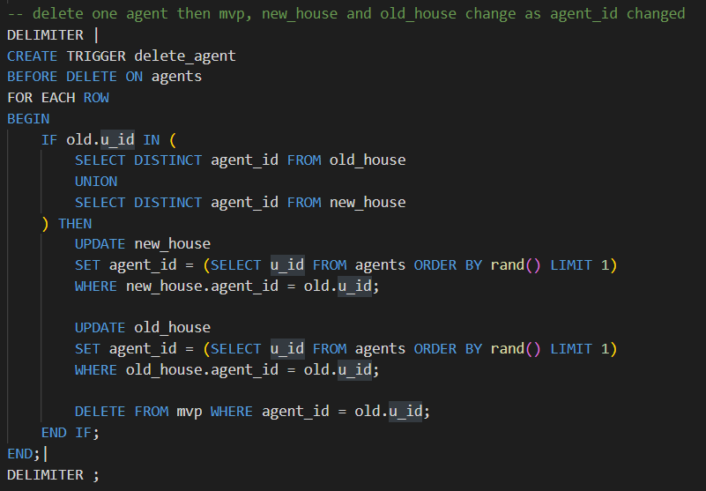
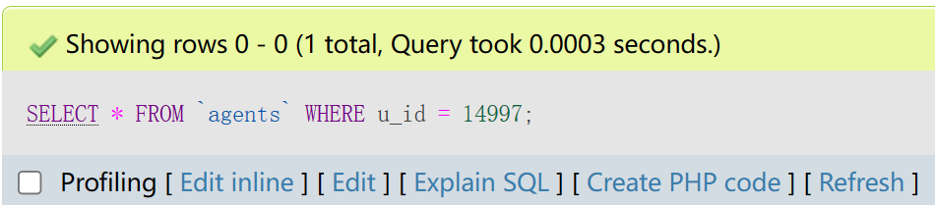
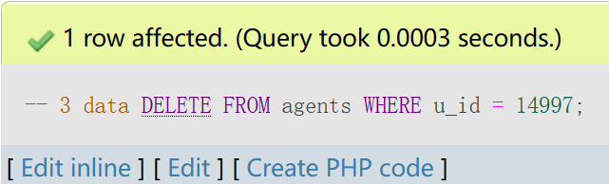
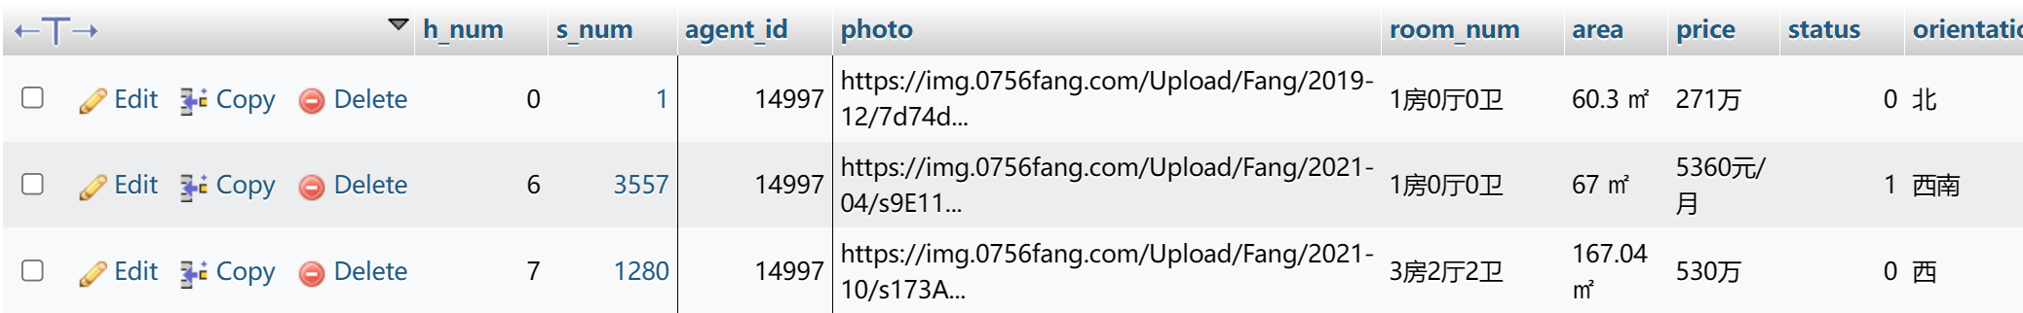
Example – trigger delete

Slide 23
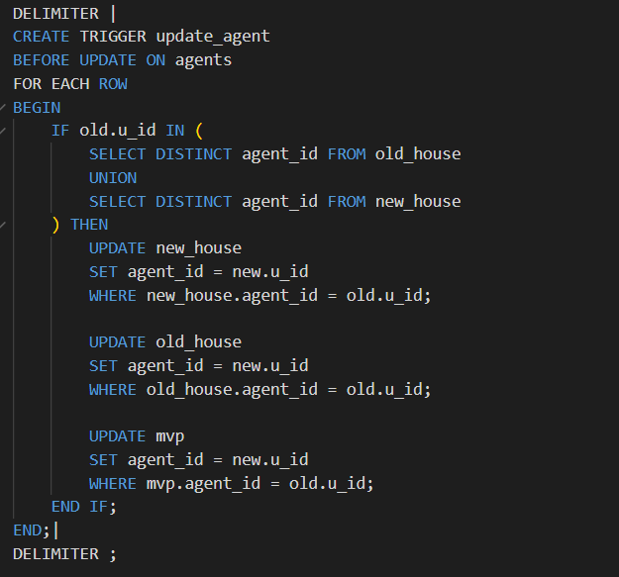
Example – trigger update

Slide 24
06
Frontend & Backend Functions
Hailin Zhong 2130026215

Slide 25
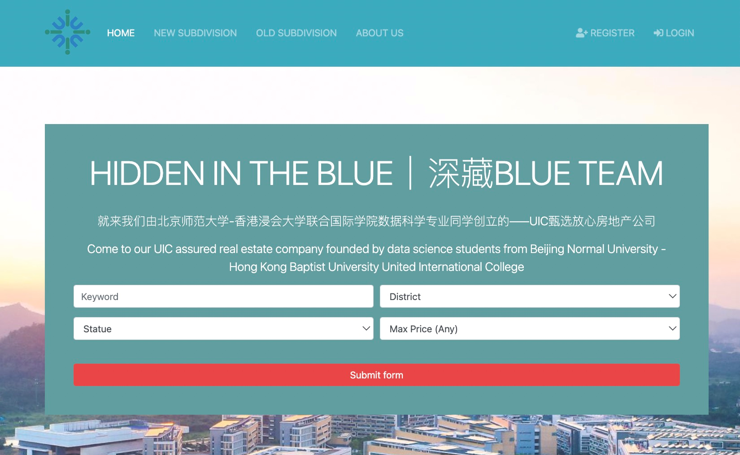
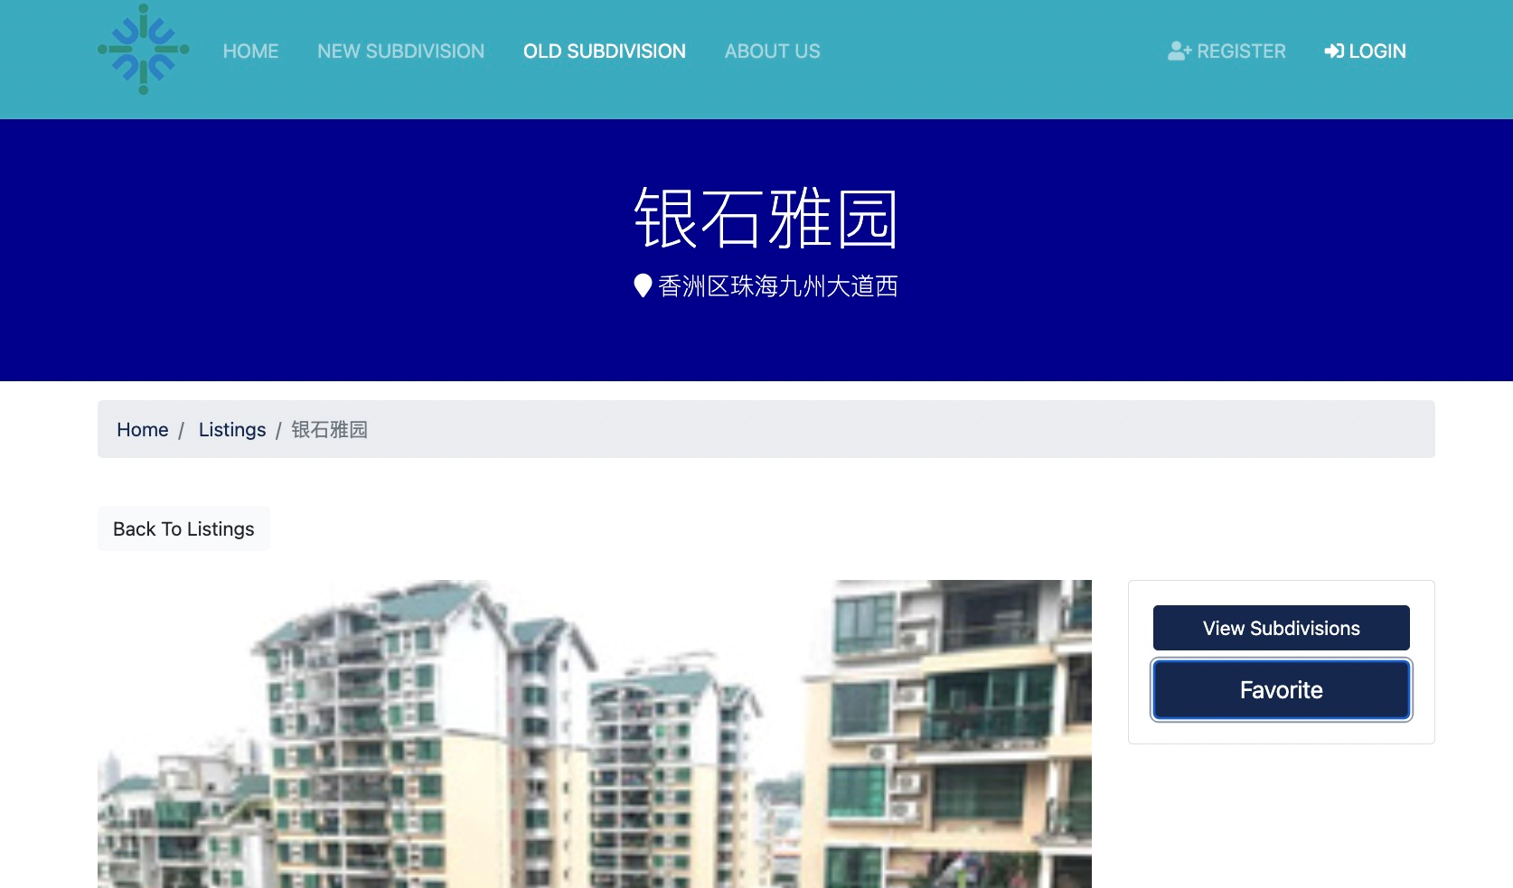
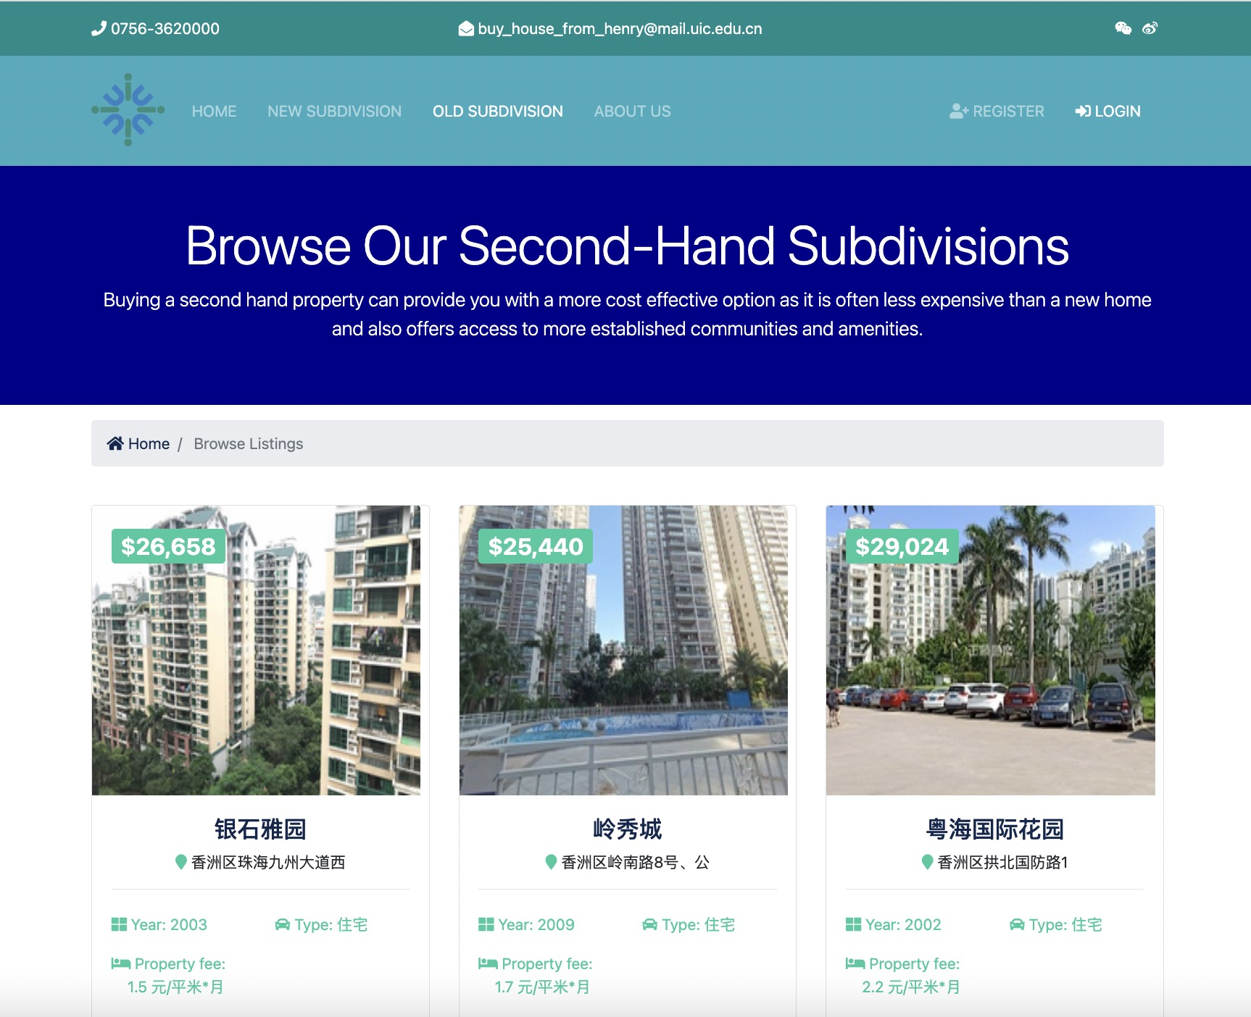
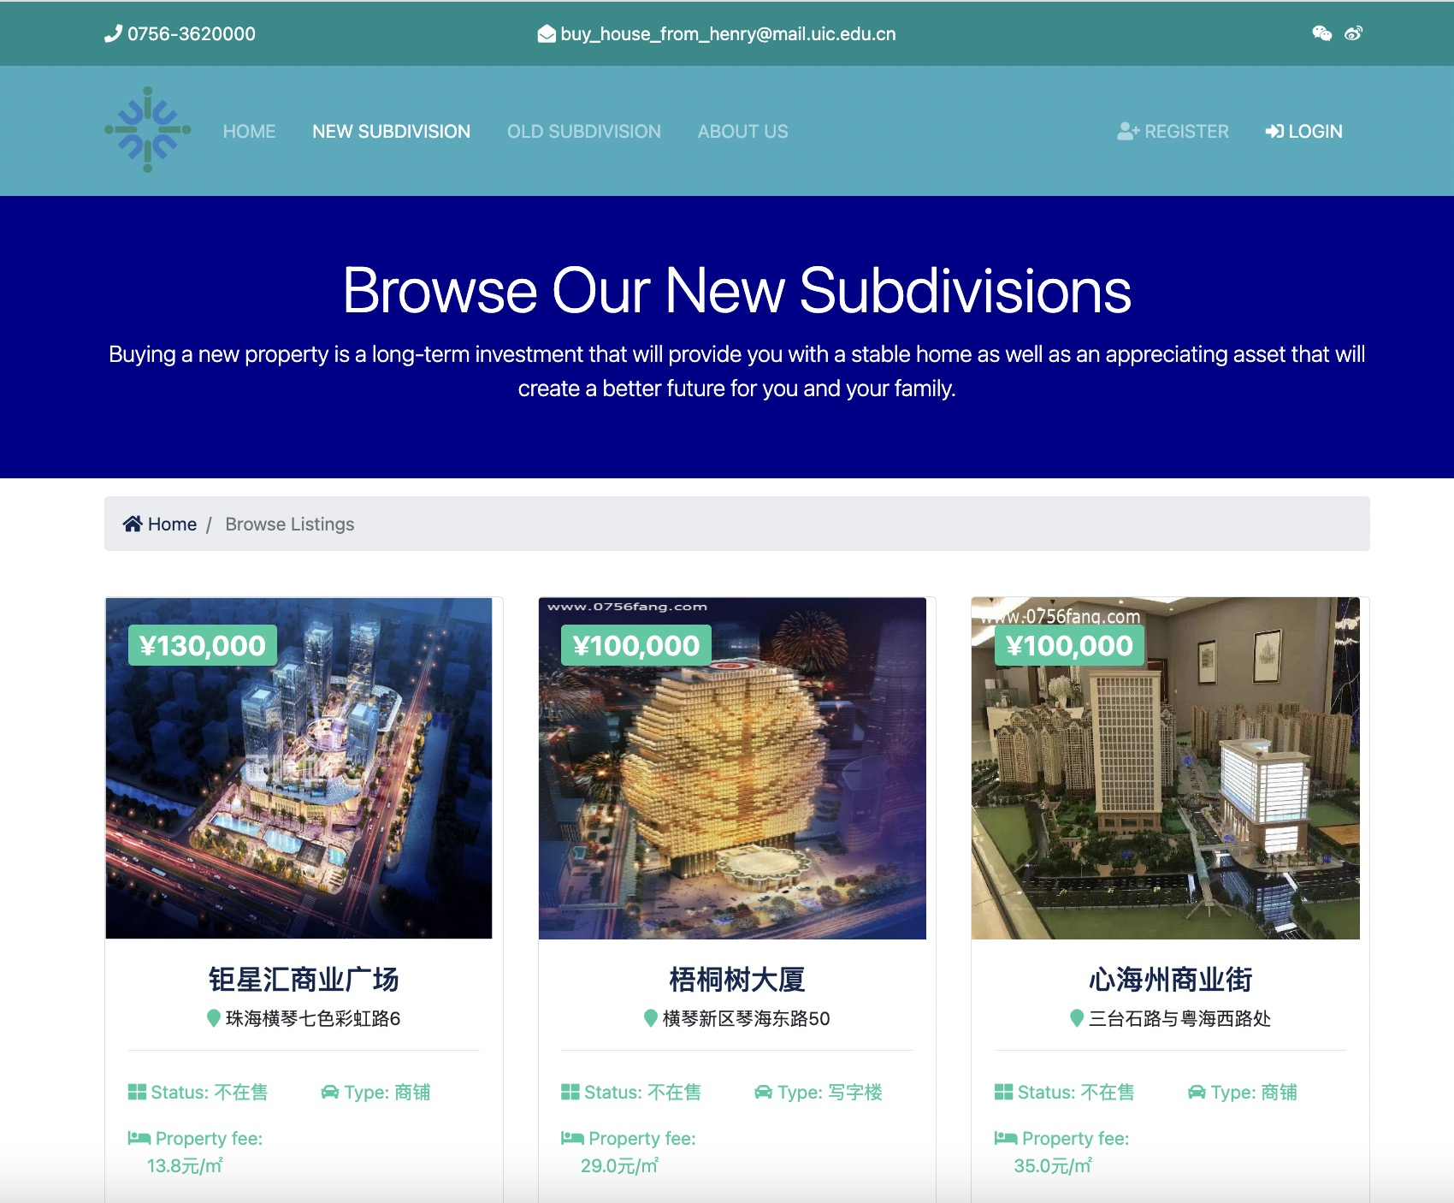
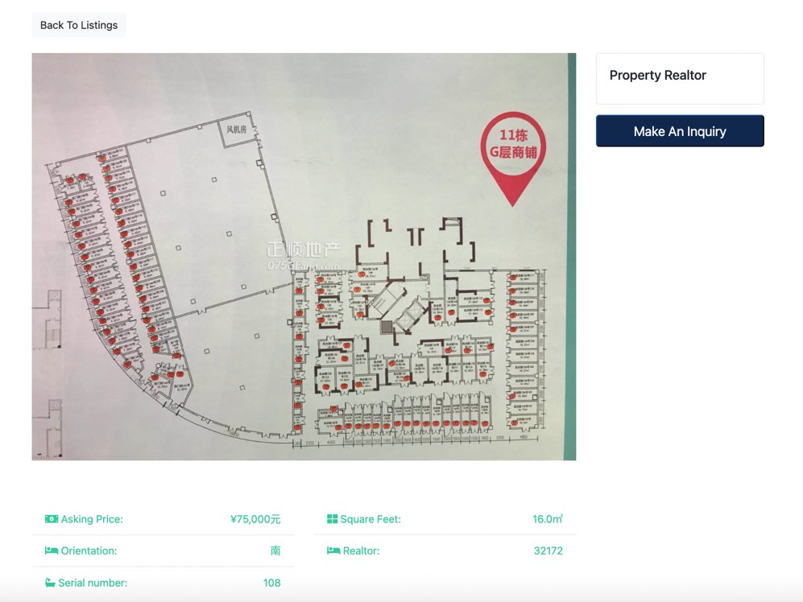
Front-end Design --- House
Home
New Subdivision
Old Subdivision
Main Function: Search the house by keyword, district, statue, or price.
Main Function: Apply to buy a house and add the subdivision to favorite.
Main Function: Apply to buy a house and add the subdivision to favorite.

Slide 26
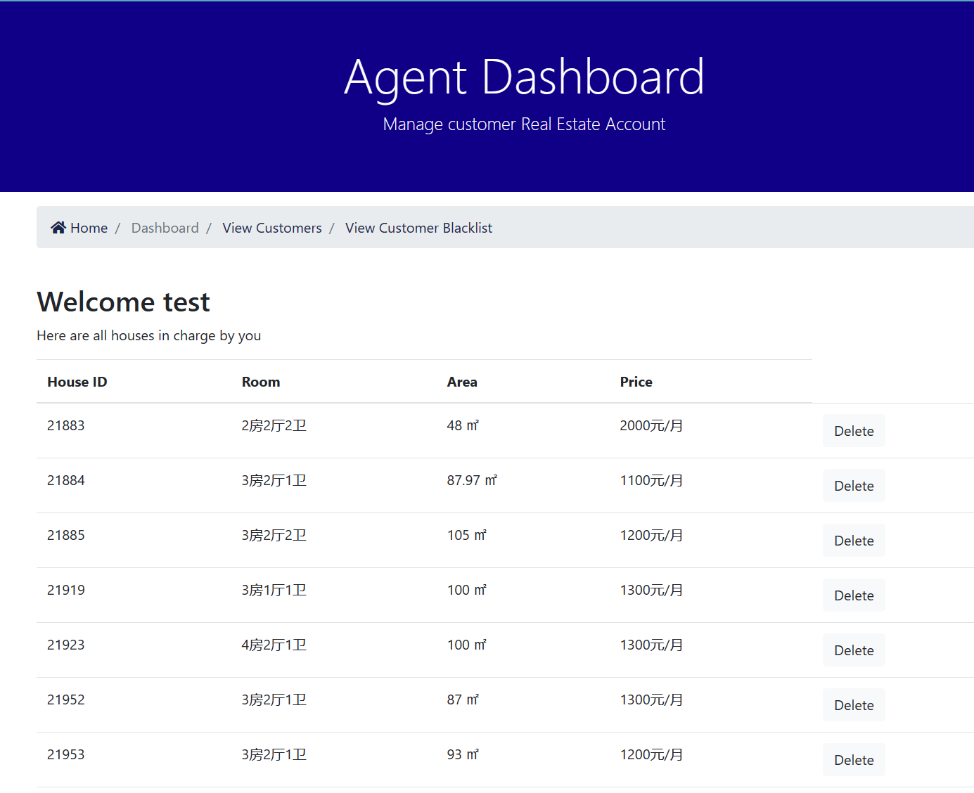
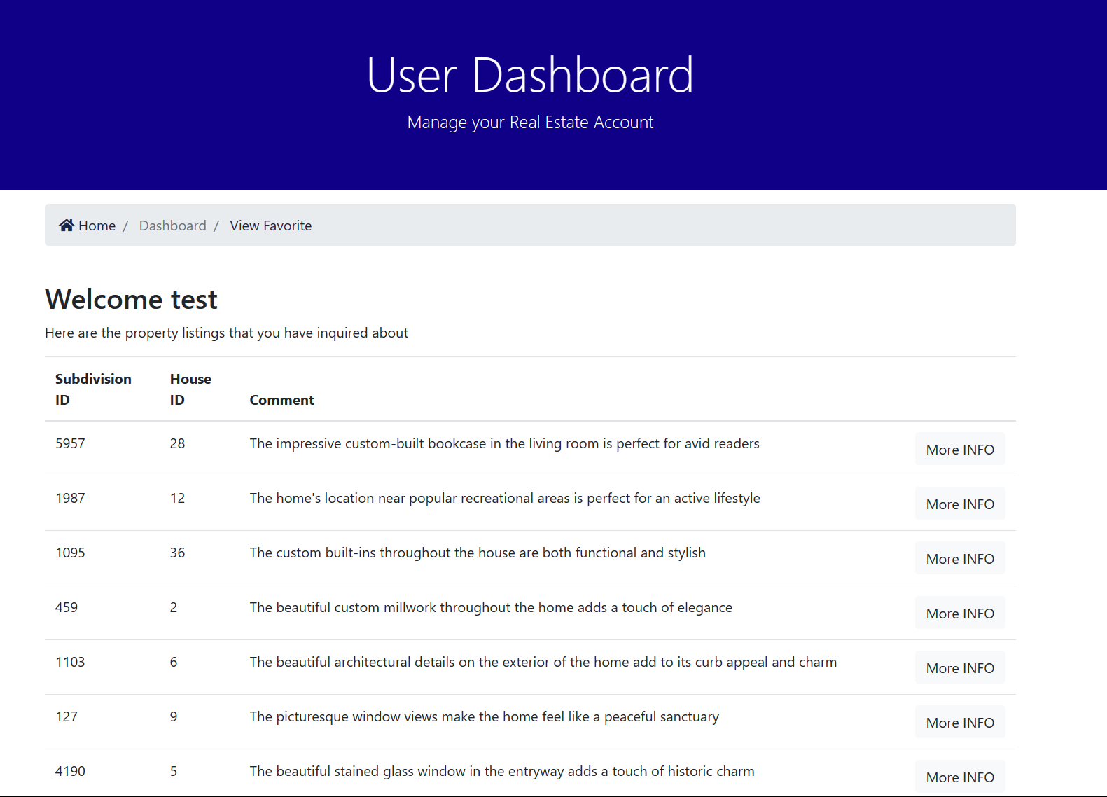
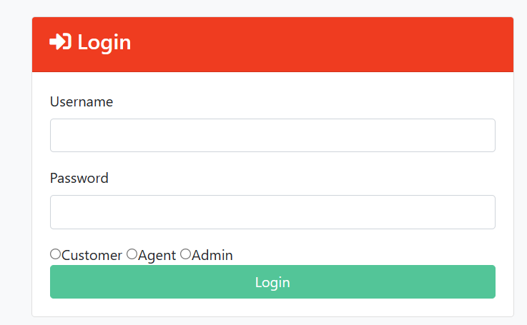
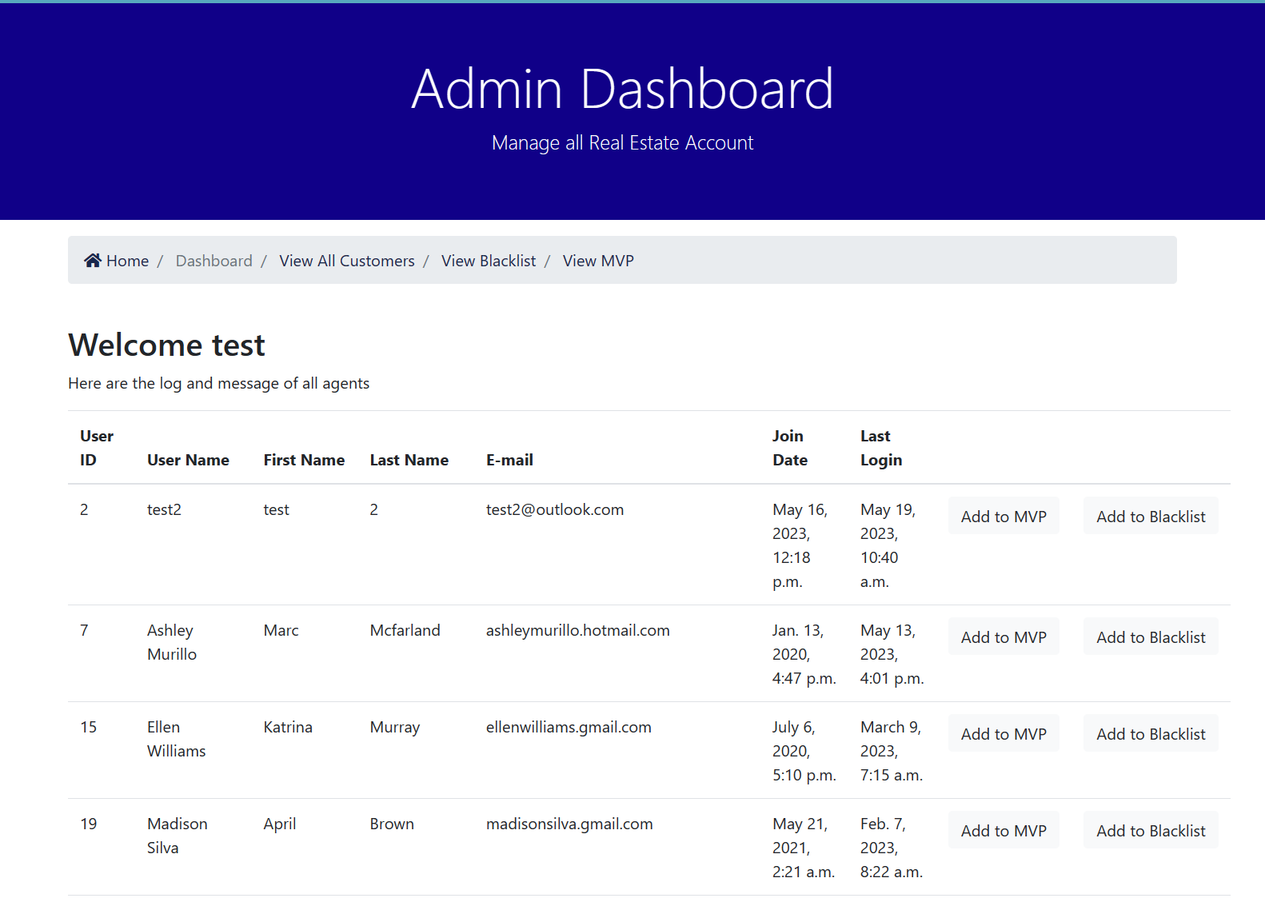
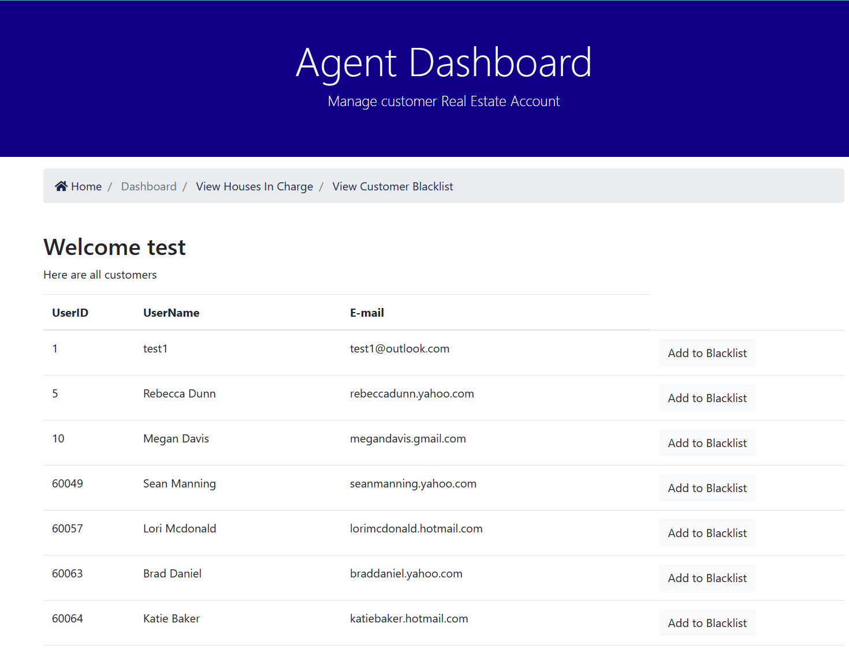
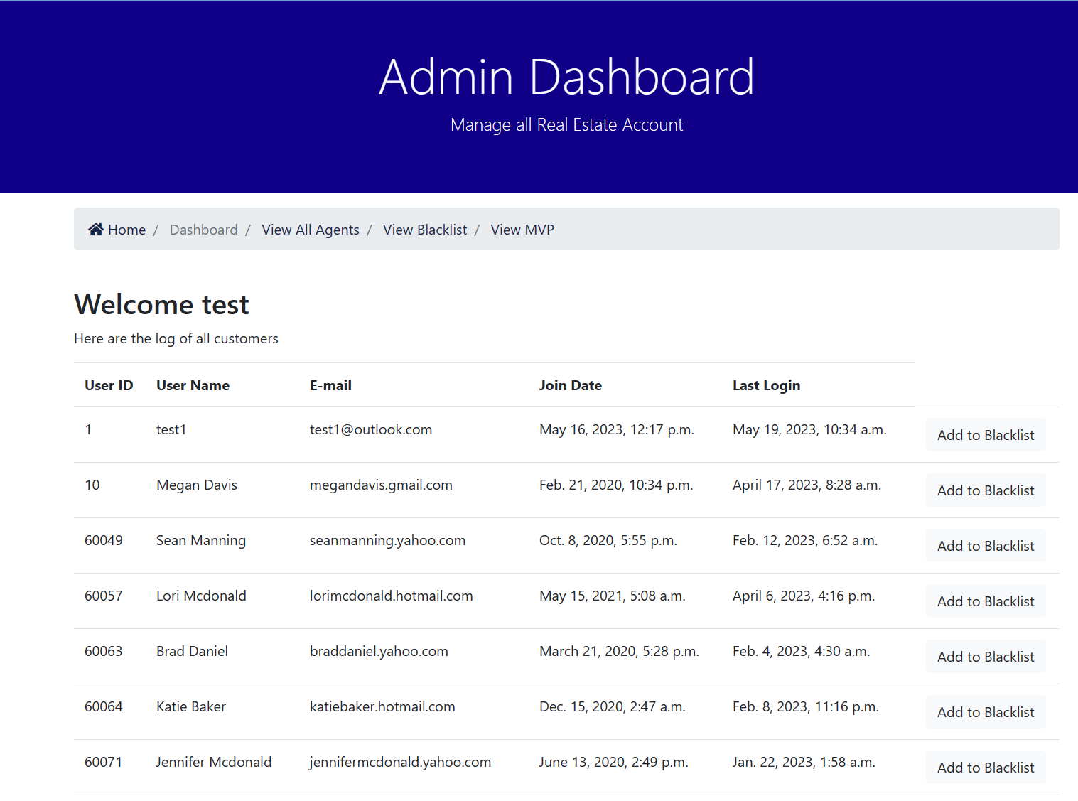
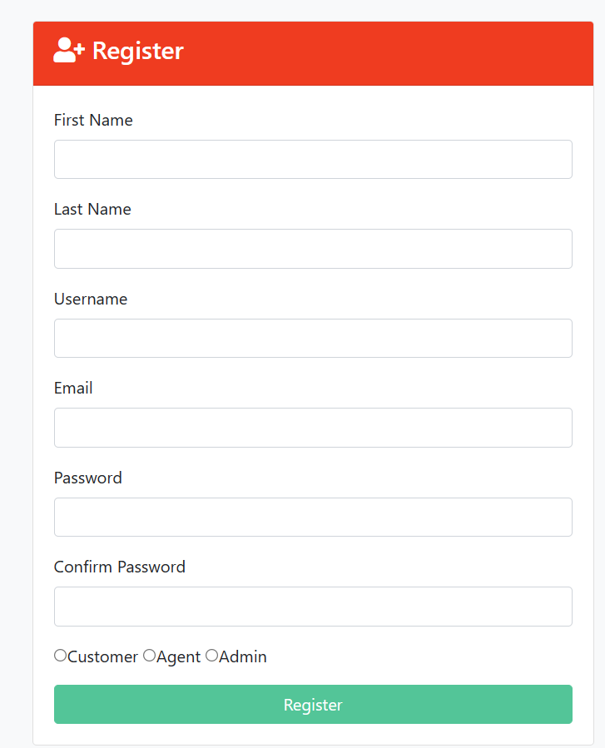
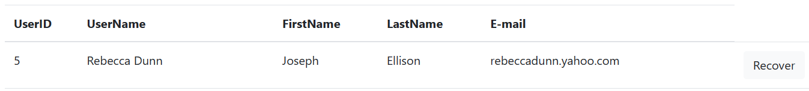
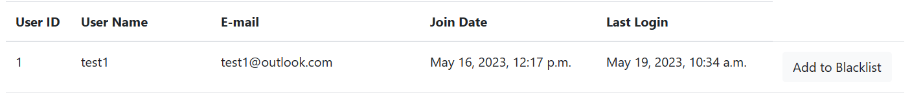
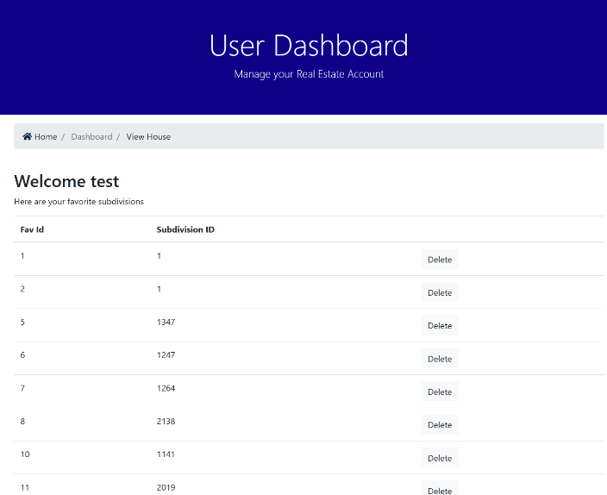
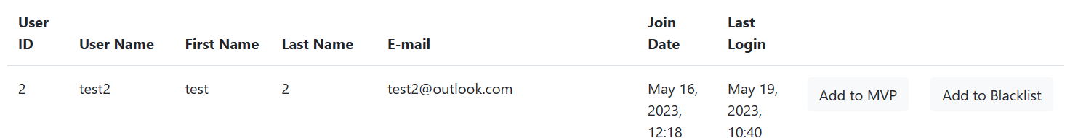
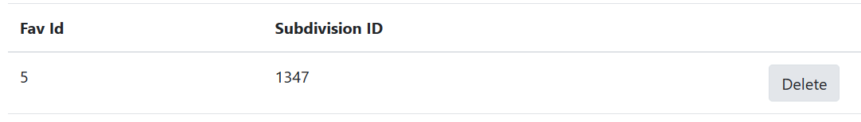
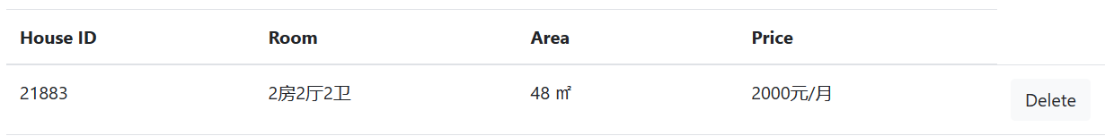
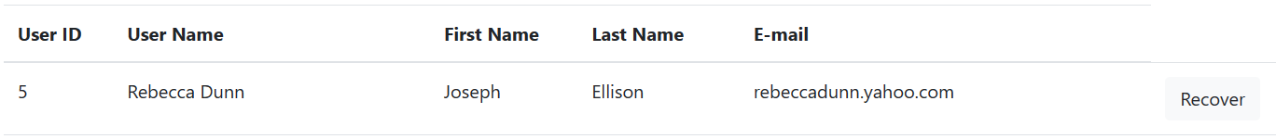
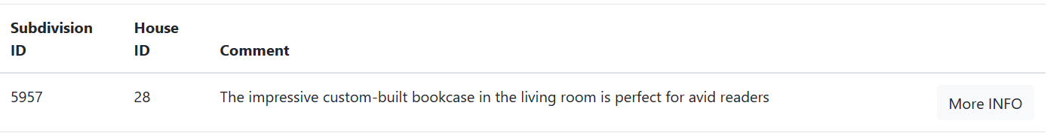
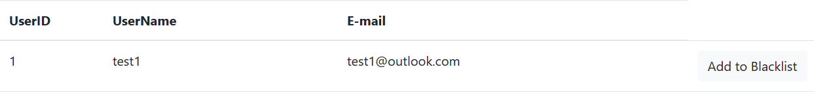
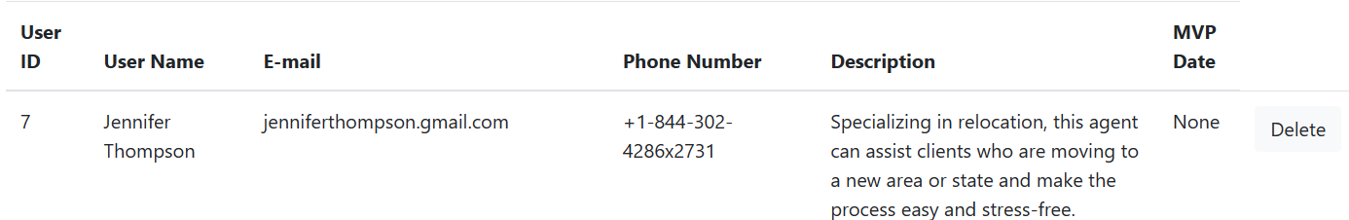
Front-end Design --- User
Customer
Agent
Admin
Main Function: View House Apply, View Favorite, House More Info, Delete Favorite
Main Function: View all Customers, View Blacklist, View Managed Houses, Add/Recover Customers to/from Blacklist
Main Function: View all Customers and agents, View Blacklist, View all MVP, Add/Recover all Users to/from Blacklist, Add/Delete Agents to/from MVP

Slide 27
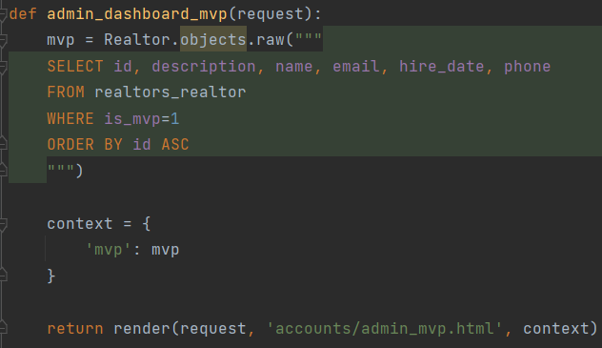
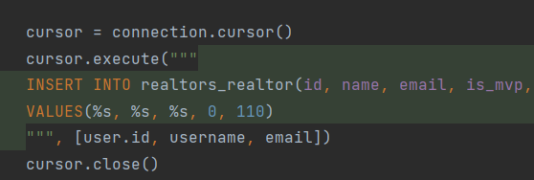
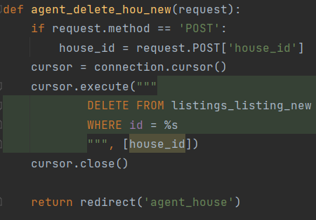
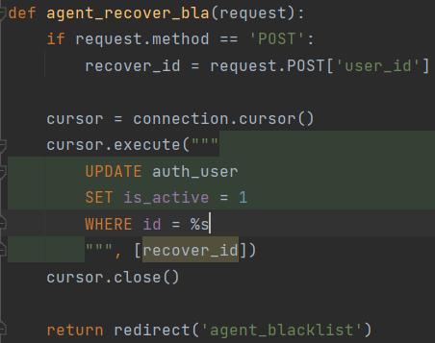
Back-end --- Achieve all Functions
Select the data from the database
Insert the data to the database
Delete the data from the database
Update the data to the database

Slide 28
Thanks!
Next, it's time for our front-end showcase.

